Slide 1
Lecture 8
Comparing to other Complex Systems. Benchmarking Cities
8.2 Comparisons between Cities and Other Complex Systems
©Luís M. A. Bettencourt 2022 @BettencourtLuis bettencourt@uchicago.edu

Slide 2
Four Principles of Urban Scaling Theory
1) Cities are mixing populations over built space and time
2) City infrastructure as decentralized but hierarchical networks
3) Personal effort is limited
4) Socioeconomic products of cities are the result of interactions,
subject to spatial costs
Jacobs, Wirth, Burgess
Alexander
Park, Milgram
Jacobs
Alonso

Slide 3
Are cities like other complex systems?
Or are they an entirely different thing?
Urban Metaphors
Cities are not organisms, any more than they are machines, and perhaps even less so. They do not grow or change of themselves, or reproduce or repair themselves. They are not autonomous entities, nor do they run through life cycles, or become infected. [...]
But it is more difficult, and more important, to see the fundamental ineptness of the metaphor and how it leads us unthinkingly to cut out slums to prevent their “infectious” spread, to search for an optimum size, to block continuous growth, to separate uses, to struggle to maintain greenbelts, to suppress competing centers, to prevent “shapeless sprawl”, and so on.
Kevin A. Lynch, Good City Form (1984).
This matters a lot actually !
Notes:
As this quote (from a very famous urbanist) states, the uncritical use of metaphor can be not only be wrong, but also hurtful. Cities has been described in terms of metaphors for most of history, so how can we point out the differences? And the uniqueness of cities as a complex system?

Slide 4
Organisms and “vascular systems”

Slide 5
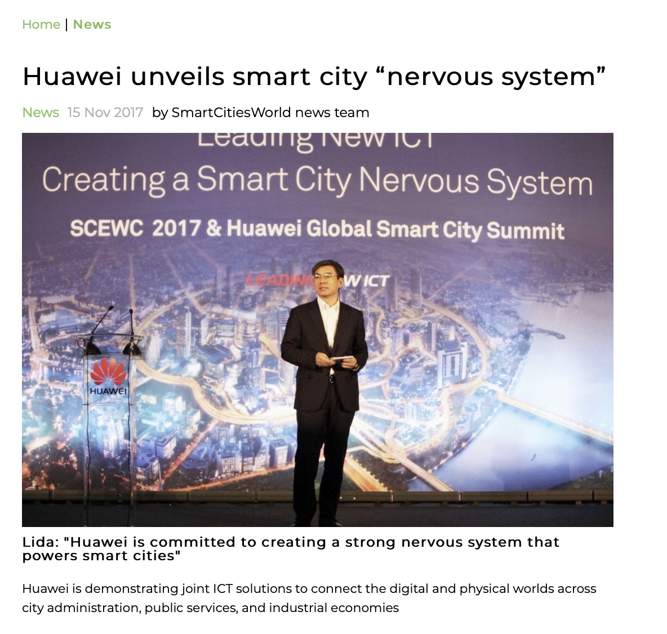

https://www.smartcitiesworld.net/news/news/huawei-unveils-smart-city-nervous-system-2305
Notes:
Here is a loose analogy of a “smart city” system to a “nervous system”. The dangerous implication is that such a model can make better decisions than people in the city in every circumstance, and that decision should be made by it, therefore. Discuss the pitfalls.

Slide 6
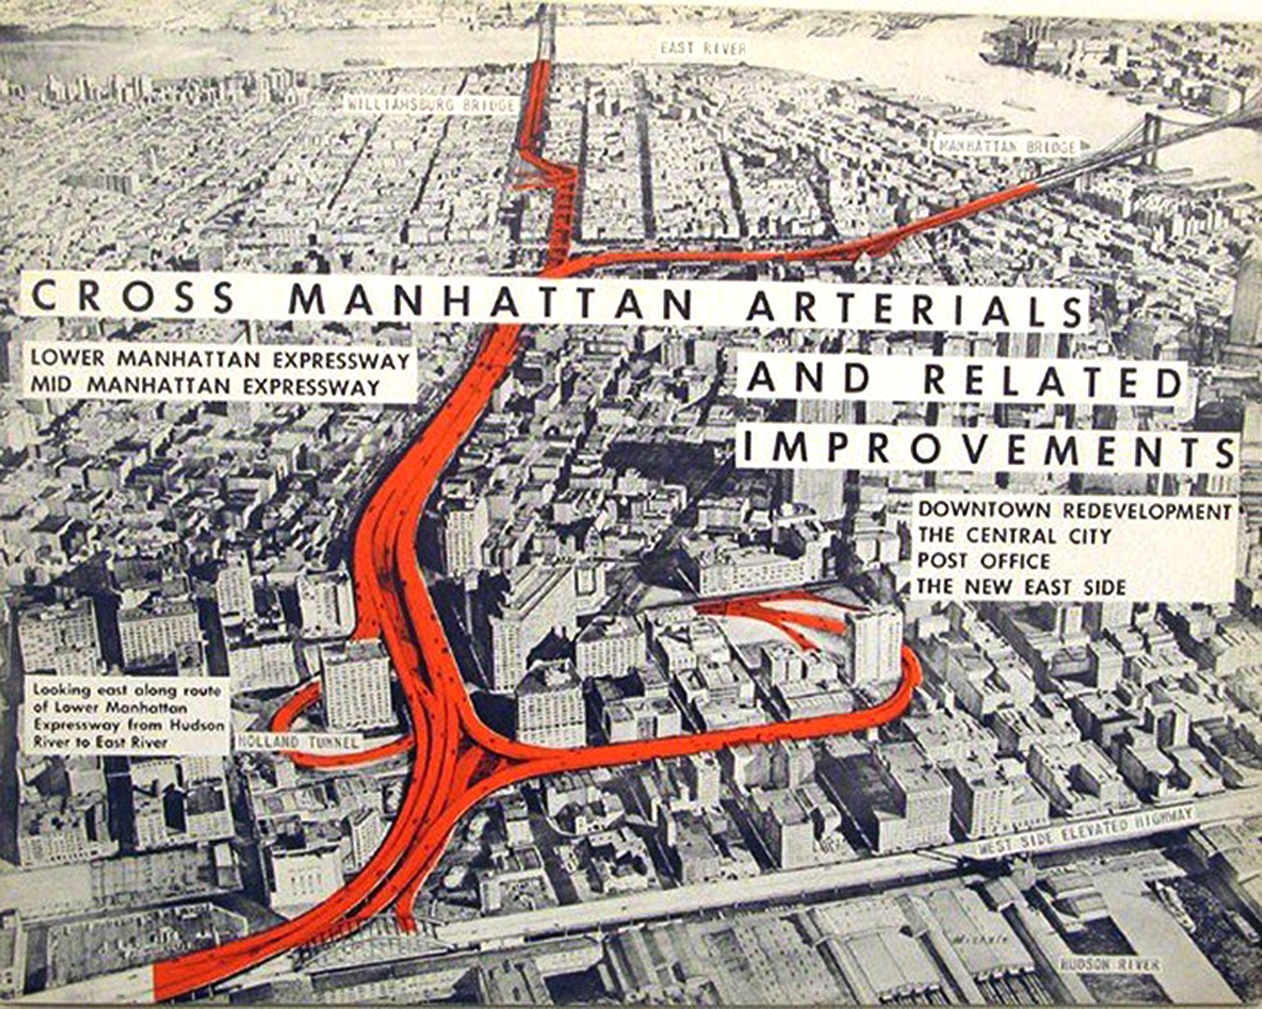

Notes:
This is a very famous figure that motivated Jane Jacobs to organize Greenwich Village communities and fight the lower Manhattan expressway, and to write her book “The death and life of great American cities”. The metaphor of the highway as the arterial system, and the implication that the city may die without (sufficient “blood flow”) is justification. Pitfalls? Discuss?

Slide 7
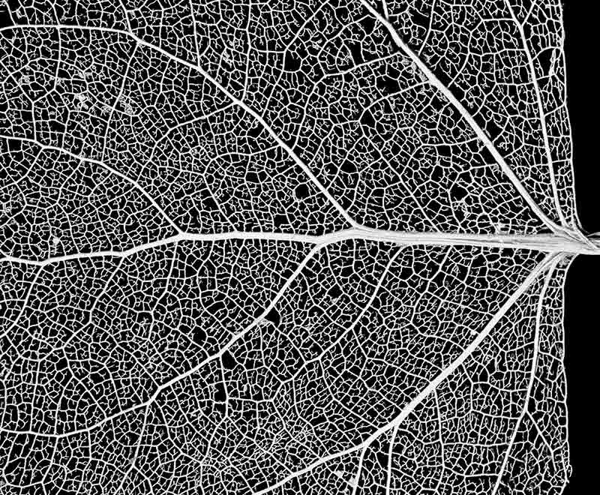
Biological Organisms?
credit: Royce Bair
Notes:
This is a beautiful picture of a leaf. We could argue that it **looks** just lot like the street networks of a city (and their hierarchy, as we theorized), along with the cells they serve being places of work and residence. But does it work the same way? Discuss. Note that the flows in the city are not hierarchical, you can travel locally in the city, and in many parallel paths (which reduced travel costs) and do not have to go through the “heart” of the city (Times Sq for NYC?) To go from A to B.

Slide 8
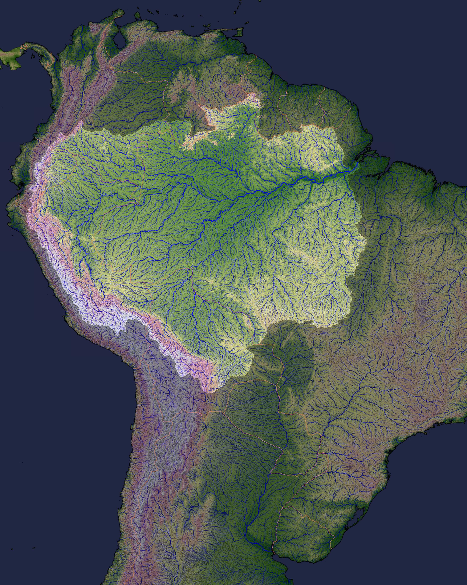
River Networks?
similar to vascular systems of plants and animals
credit: NASA
Notes:
Just to make that point further: The structure of circulatory systems of plants and animals (in 3D) are analogous to river networks (in 2D). These systems are explained by minimizing energy dissipation under constraints, and must thus slow down larger systems relative to smaller, the opposite of cities.

Slide 9
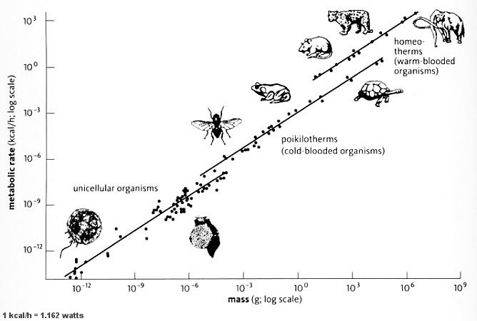
The Energy Use of Biological Organisms
Kleiber’s Law
Energy/time ~ Mass ^{3/4}
sublinear
Power or Metabolism
West, Brown, Enquist 1997, …
Notes:
This slowing down, is clear in terms of a well known “law” of biological metabolism, called Kleiber’s Law. This says that larger organisms use less energy per unit mass, and as a consequence are slower, but live longer.

Slide 10
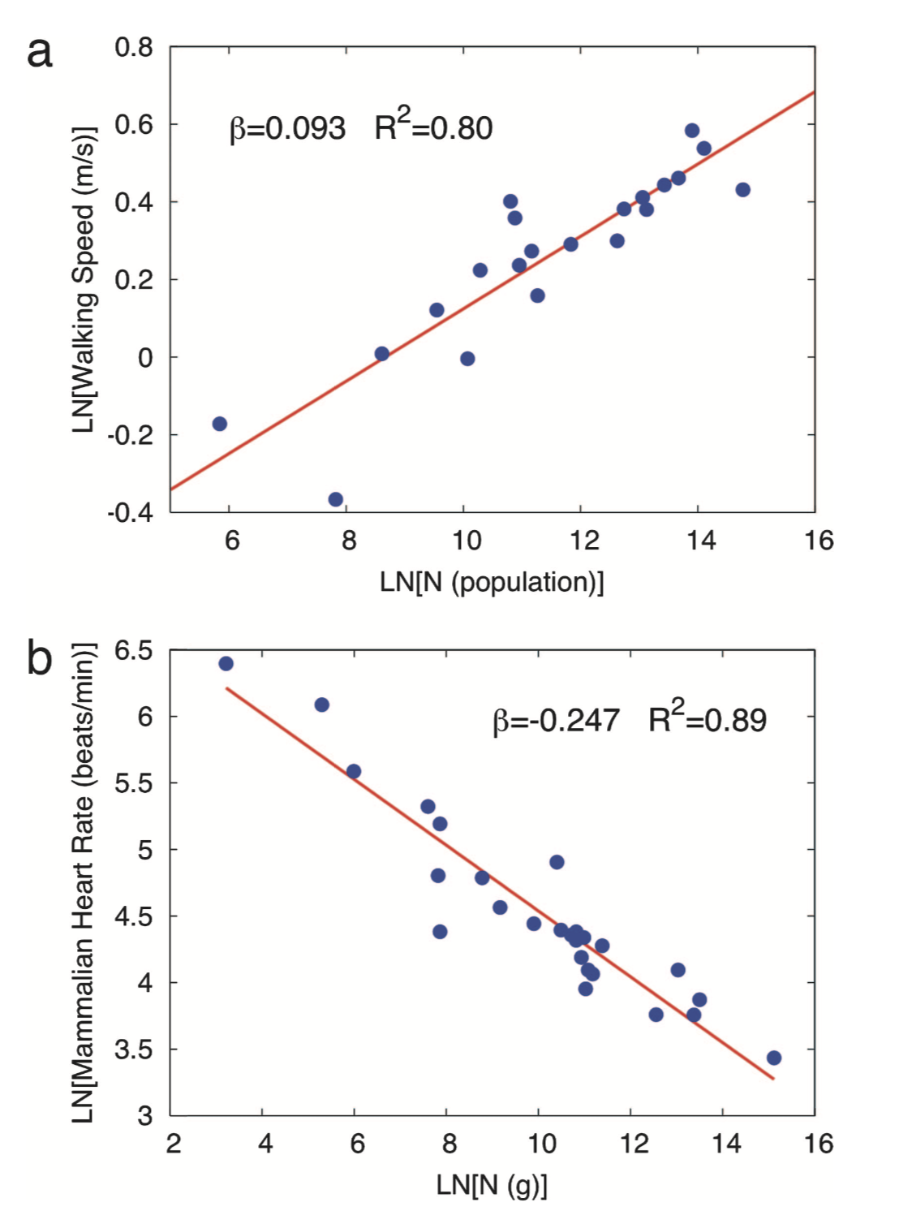
superlinear
Speed of Life in Cities
(walking)
increases with scale
strong heterogeneity
innovation and change
Speed of Life in Nature
(organism’s heart rate)
sublinear
decreases with scale
no diversity
energy efficiency
Notes:
And here is an image (from our 2007 PNAS paper) that makes this point clearly, I think, about the heart rate (biology) and walking speed (“social”). The first decelerating and the second accelerating with size of (its) system.

Slide 11
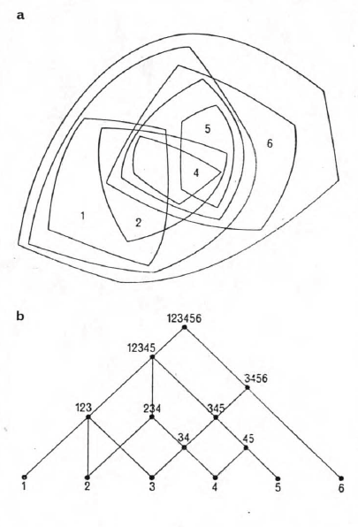
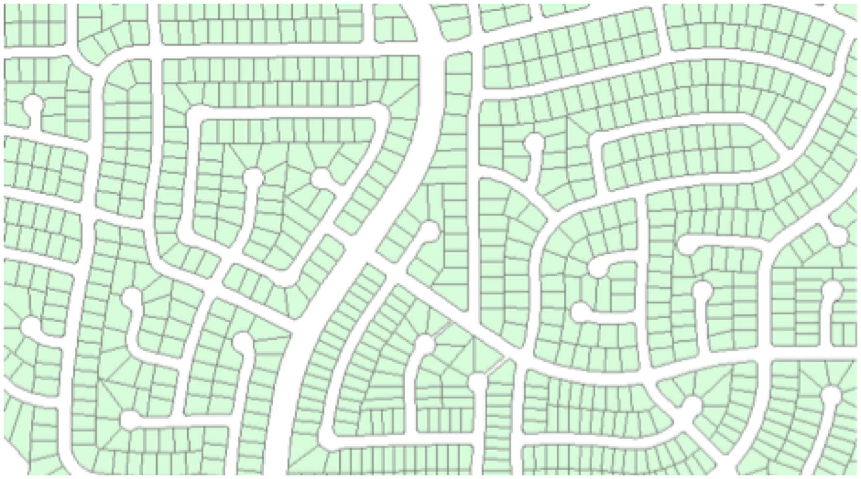
But cities are actually decentralized networks
You don’t have to go through Times Square, to go from Chinatown to Wall Street …
Las Vegas NM
credit: Christa Brelsford
C. Alexander
The city is not a tree
Cities are NOT driven by energy efficiency !!
What are cities driven by, if not energy efficiency?

Slide 12
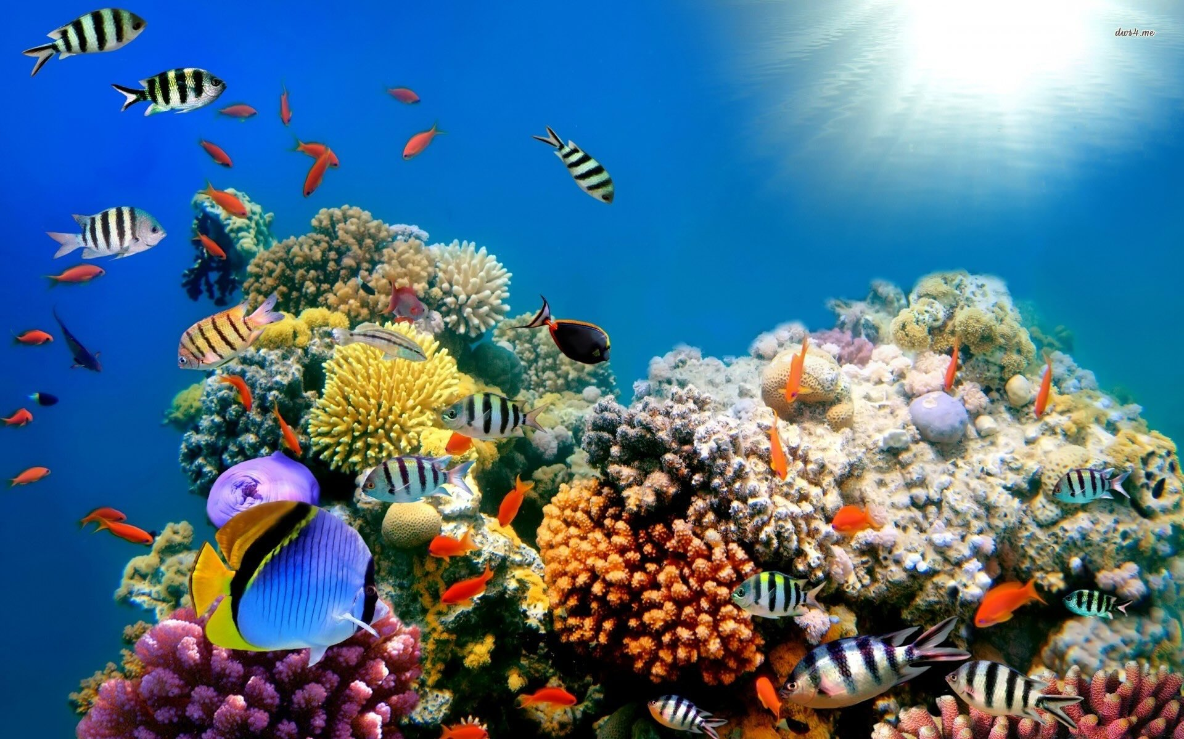
Ecosystems?
A Jane Jacobs favorite
driven by increased fitness
~growth rates of populations
credit: www.mostbeautifulthings.net
Notes:
Another common metaphor are ecosystems… especially a focus on the creation of diversity. This is maybe a more benign analogy, but in general ecosystems are much more energy limited than (modern) cities…

Slide 13
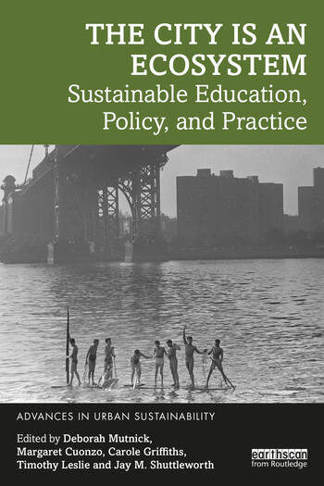
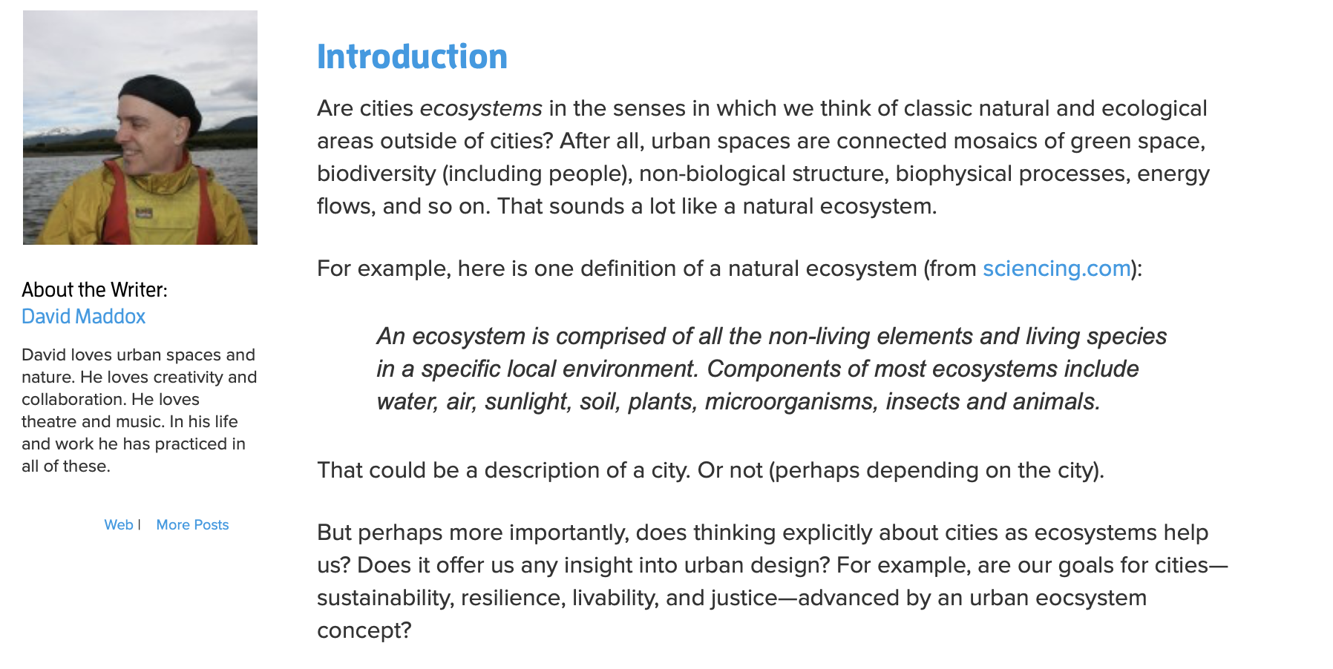
Ecosystems?
https://www.thenatureofcities.com/2017/06/30/cities-ecosystems-analogous-natural-ones-nature-infrastructure-people-thinking-cities-way-help-us-think-urban-design/
https://www.routledge.com/The-City-is-an-Ecosystem-Sustainable-Education-Policy-and-Practice/Mutnick-Cuonzo-Griffiths-Leslie-Shuttleworth/p/book/9781032108650
Notes:
The city, of course, is an ecosystem itself, though biological ecosystems in cities are in close interaction with human selection and resources which makes them interesting and relatively poorly understood as ecologies…

Slide 14
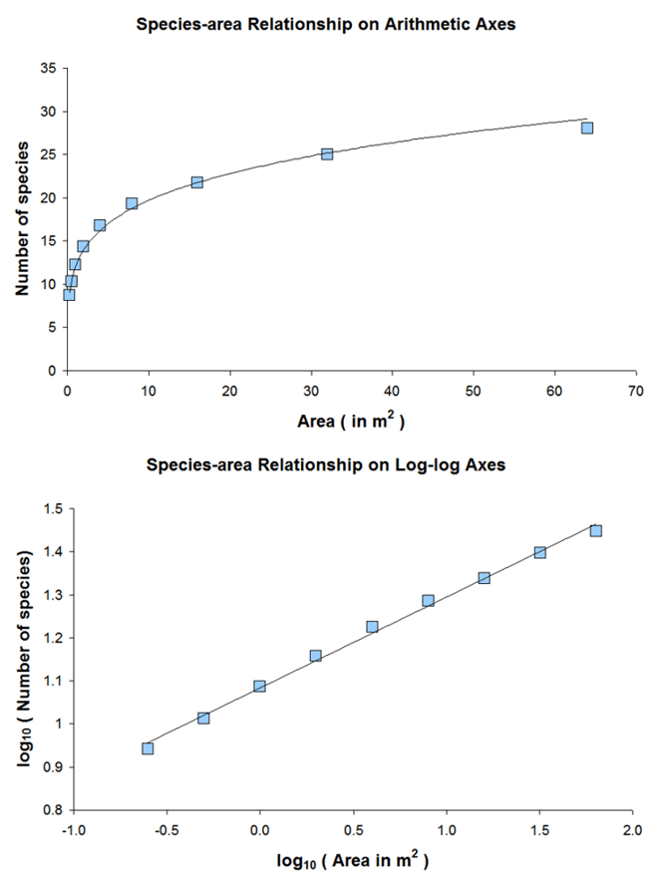
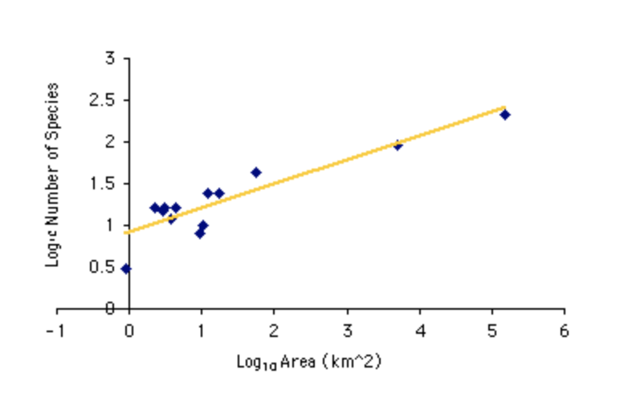
A law of diversity in nature
Species-Area Law
$$D=cA^{z}$$
$$z∼1/4$$
number of species vs. habitat area
$$z=0.29$$
Browne and Peck 1996
credit: Louis J. Gross
Cities show much greater diversity and much greater power density (achievable by importing resources)
$$D=cN^{5/6}$$
Notes:
The laws of diversity (here I am comparing species vs area to professions vs population) are much faster in cities, in part because there are more resources (brought in). There are some surveys that biological biodiversity is often also larger (but also different) in cities than in environments outside, because of more resources and niches. This suggests that the dynamics of interaction, specialization and interdependence is fundamentally different in cities relative to ecosystems. But more detailed research in both systems on this question is necessary.

Slide 15
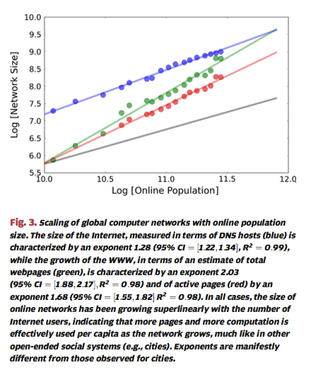
Internet?
closer to Metcalfe’s law
There is no physical space on the internet…
Bettencourt, IEEE, 2014
Notes:
The internet also scales super linearly, but the exponents are larger, consistent with Metcalfe’s exponent, beta =2 (not constrained by space)… as maybe could be anticipated.

Slide 16
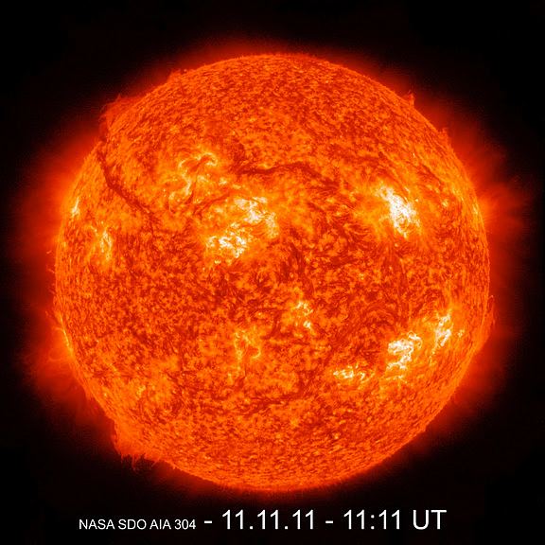
Stars?
NASA
Notes:
An interesting new analogy is with a star: A star creates products of interaction (light, neutrinos, heavier elements) out of compressing matter spatially. It is a nuclear reactor.

Slide 17
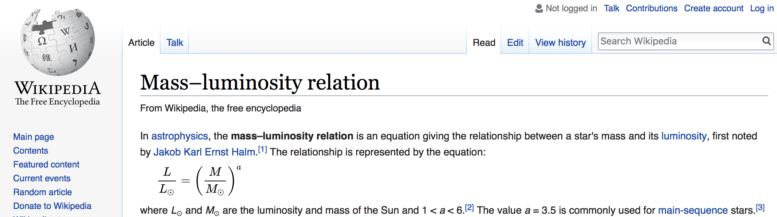

For Stars
Light is Superlinear on Mass
different exponents !
More massive stars burn brighter per unit mass, live shorter lives.
Notes:
Because the observable products of a star, such as light, result from interactions between matter (mass), there is a superlinear relationship between them and the star’s mass. The exponent is again different, because the processes are clearly different (nuclear vs social) and in 3D rather than 2D.

Slide 18
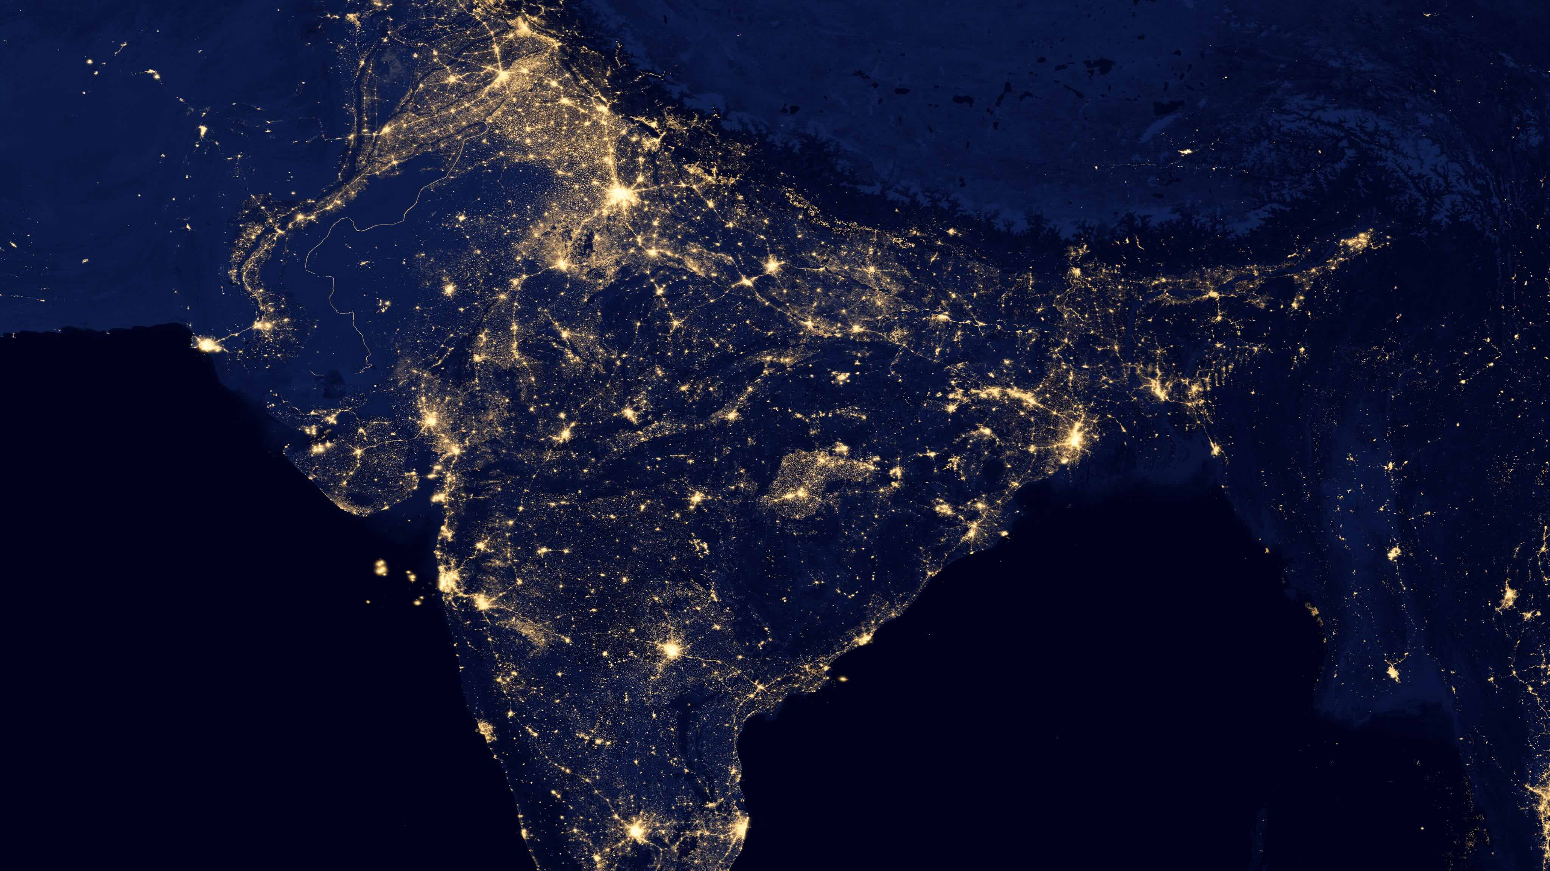
networks that act “a bit” like stars
credit: NASA 2012
Notes:
The analogy of these effects is nevertheless beautiful and suggestive, such as shown by Earth at night images, this one over India, where the brightest spots are the largest cities.

Slide 19
Cities are
general-purpose
“Social Reactors”
They intensify and sustain rates of large scale social interactions of all kinds
What for? Who benefits? What about inequality?
Notes:
The analogy to stars motivates thinking about cities as “social reactors”: The structure of cities described by urban scaling theory supports the scale-invariant intensification of social interactions, with a superlinear production of all manner of social and economic products.

Slide 20
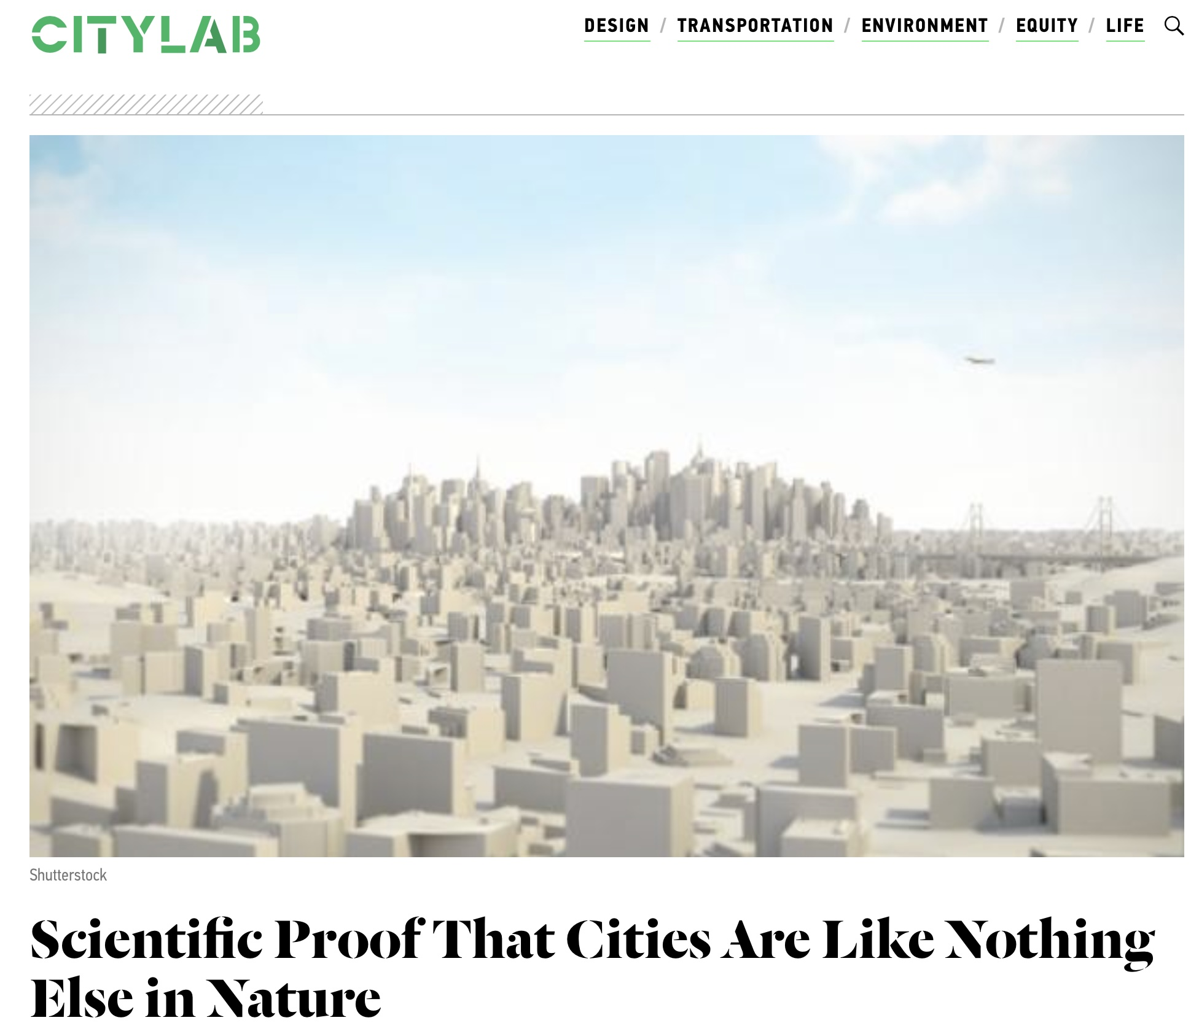

https://www.bloomberg.com/news/articles/2013-06-20/scientific-proof-that-cities-are-like-nothing-else-in-nature
Notes:
But the main lesson from developing our models so far is that cities are unlike any other complex system, even if many complex system also show scaling but with different exponents for different quantities. Scaling, as we have seen, expresses the nature of structures that are preserved across scales and is necessary for any recognizable complex system that appears at many different sizes: organisms, river networks, the internet, ecosystems, … and cities. But different such structures for different systems.

